Slide 1

CRIME AGAINST WOMAN

Slide 2

ABOUT:
This project contains the data record of all types of crime against women in India in the span of years 2001-2014. The main aim of working on this project is to reflect on the situation of women in our society and raise concern about this matter.

Slide 3
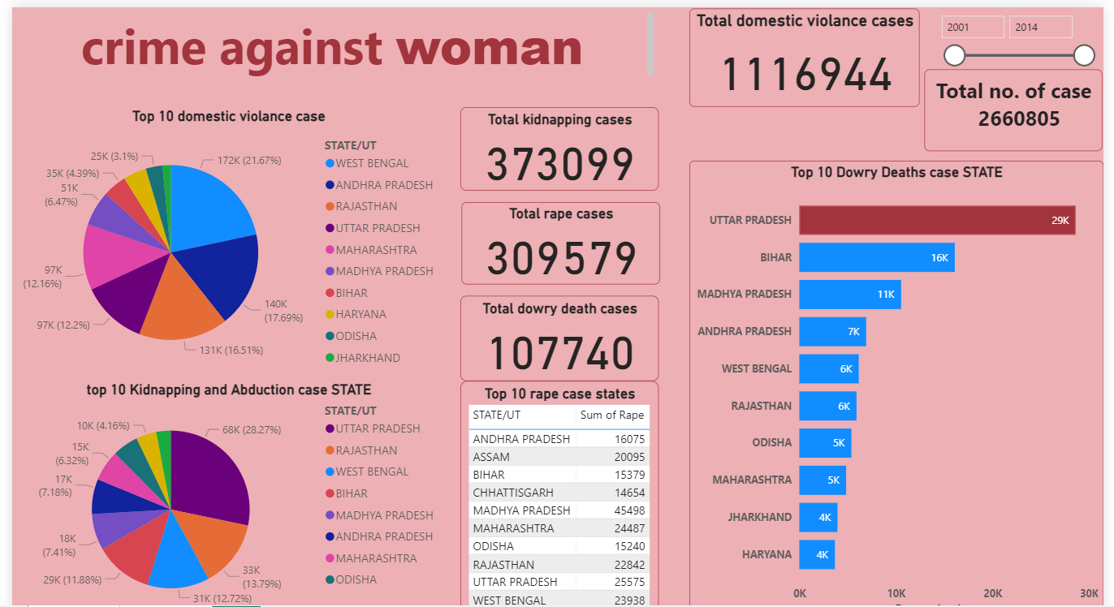

Slide 4

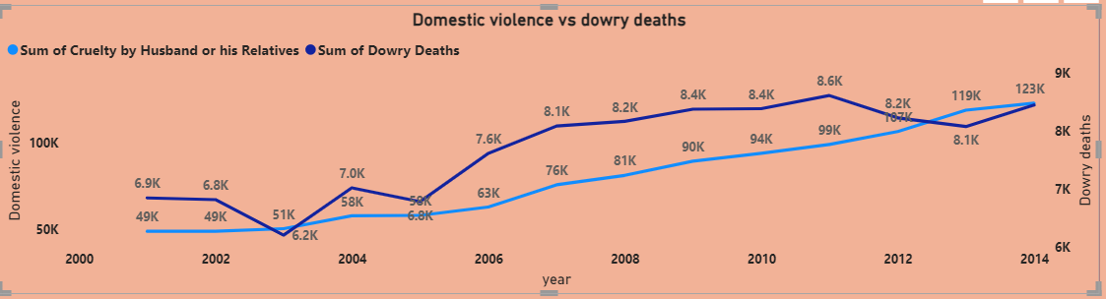
SUMMARY:
According to data both, domestic violence and dowery deaths , increasing 2000 - 2014

Slide 5


Slide 6



THANK YOU
SUBMITTED BY : SUMAN
SAUMYABISHNOI2929@GMAIL.COM
www.linkedin.com/in/suman-bishnoi-618799273
https://peerlist.io/suman29/signup

